Slide 1

Database Management System
Lab # 3 (Joins)

Slide 2
DDL CONSTRAINTS- DATA DEFINITION LANGUAGE
DDL is a standard subset of SQL that is used to define tables (database structure), and other metadata related things.
DDL statements create, modify, and remove database objects such as tables, indexes, and users.
The most important DDL statements in SQL are:
CREATE DATABASE - creates a new database
CREATE TABLE - creates a new table
ALTER TABLE - modifies a table
DROP TABLE - deletes a table

Slide 3
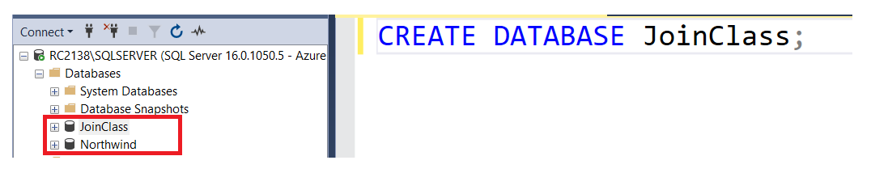
CREATE DATABASE STATEMENT
The CREATE DATABASE statement is used to create a database.
-- CRAETE DATABASE SYNTAX
Create Database <database_name>

Slide 4
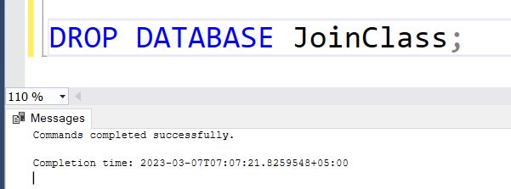
DROP DATABASE STATEMENT
The DROP DATABASE statement is used to delete a database.
-- DROP DATABASE SYNTAX
DROP DATABASE <database_name>

Slide 5
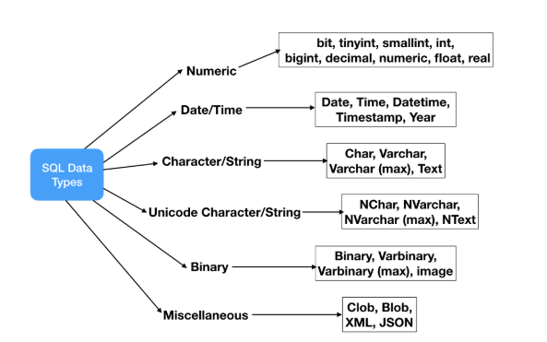
CREATE TABLE STATEMENT
The CREATE TABLE statement is used to create a table in a database.
Syntax:
CREATE TABLE table_name
(
column_name1 data_type,
column_name2 data_type,
column_name3 data_type,
....
)

Slide 6
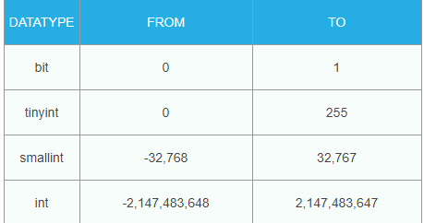
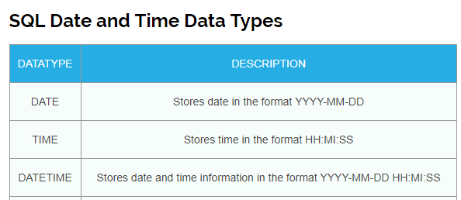
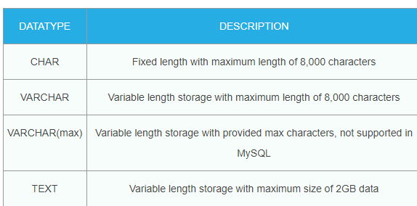
SQL Numeric Data Types
SQL DATE/ TIME Data Types
SQL CHARACTER / STRING Data Types

Slide 7
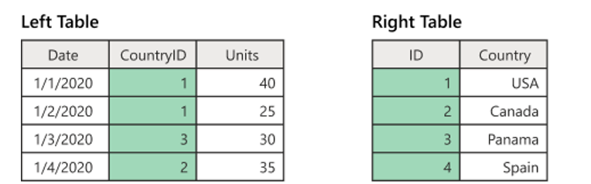
CREATE TABLE STATEMENT
DROP TABLE LeftTable ;
CREATE TABLE LeftTable(
date DATE,
country_id INT,
units INT
);
INSERT INTO LeftTable(date, country_id, units)
VALUES
('1-1-2020', 1, 40),
('1-1-2020', 1, 25),
('1-3-2020', 3, 30),
('1-2-2020', 2, 35);
SELECT *
FROM LeftTable;

Slide 8
CREATE TABLE STATEMENT

Slide 9
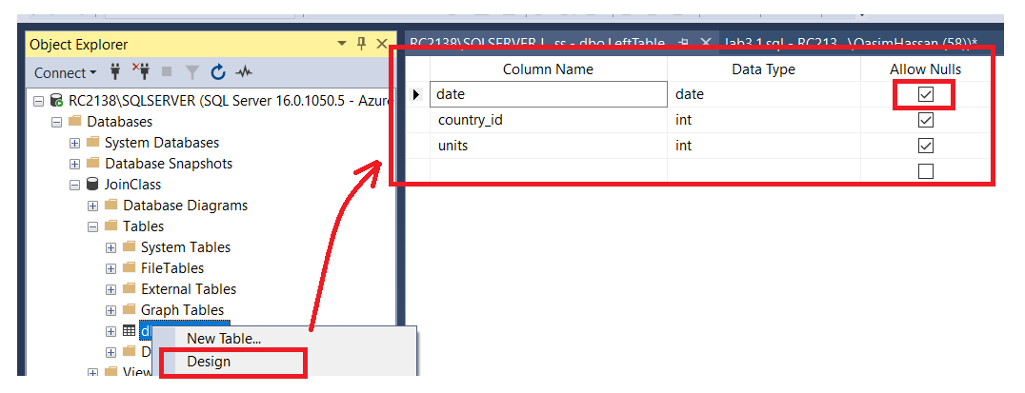
CREATE TABLE STATEMENT
Right click on Persons Table and then click on Design.

Slide 10
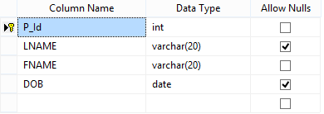
CREATE TABLE STATEMENT
CREATE TABLE Employee(
P_Id INT,
LNAME VARCHAR (20),
FNAME VARCHAR (20) NOT NULL,
DOB DATE,
PRIMARY KEY(P_Id)
);
Note: Only those columns can be a Primary Key that do not allow null values.

Slide 11
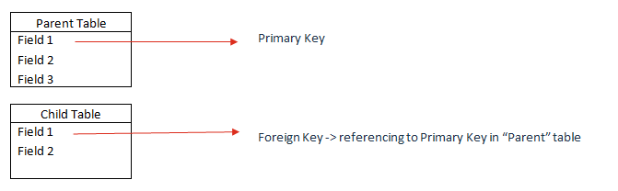
CREATE TABLE STATEMENT
CREATE TABLE Department(
Dept_code INT,
P_Id INT,
PRIMARY KEY (Dept_code),
FOREIGN KEY (P_Id) REFERENCES Employee(P_Id)
);

Slide 12
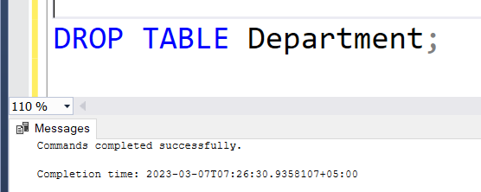
DROP TABLE STATEMENT
The DROP TABLE statement is used to delete a table.
-- DROP TABLE Syntax:
DROP TABLE <table_name>

Slide 13
ALTER TABLE STATEMENT
--ALTER Example 1:
ALTER TABLE Persons
ADD DateOfBirth date
-- ALTER Example 2:
ALTER TABLE Persons
DROP COLUMN DateOfBirth

Slide 14
TASKS:
Create a database Name persons.
Create table name student and add fields (id, First Name, last Name, Enrollment Number, semester)
Use alter statement to add column Address (table student)
Insert some records into the tables (Add at least 10 records to the table)
Display the student table with all its records.
Use Drop statement to drop the table.
Use Drop statement to drop the database.
Completed ‘Joining Data With SQL’ course from Datacamp.

Slide 15
Database Management System
Lab # 4 (Joins)

Slide 16
SQL JOINS
SQL JOINS are used to retrieve data from multiple tables. A SQL JOIN is performed whenever two or more tables are joined in a SQL statement.
TYPES OF JOINS
INNER JOIN (or sometimes called simple join)
LEFT OUTER JOIN (or sometimes called LEFT JOIN)
RIGHT OUTER JOIN (or sometimes called RIGHT JOIN)
FULL OUTER JOIN (or sometimes called FULL JOIN)
CROSS JOIN
SELF JOIN

Slide 17
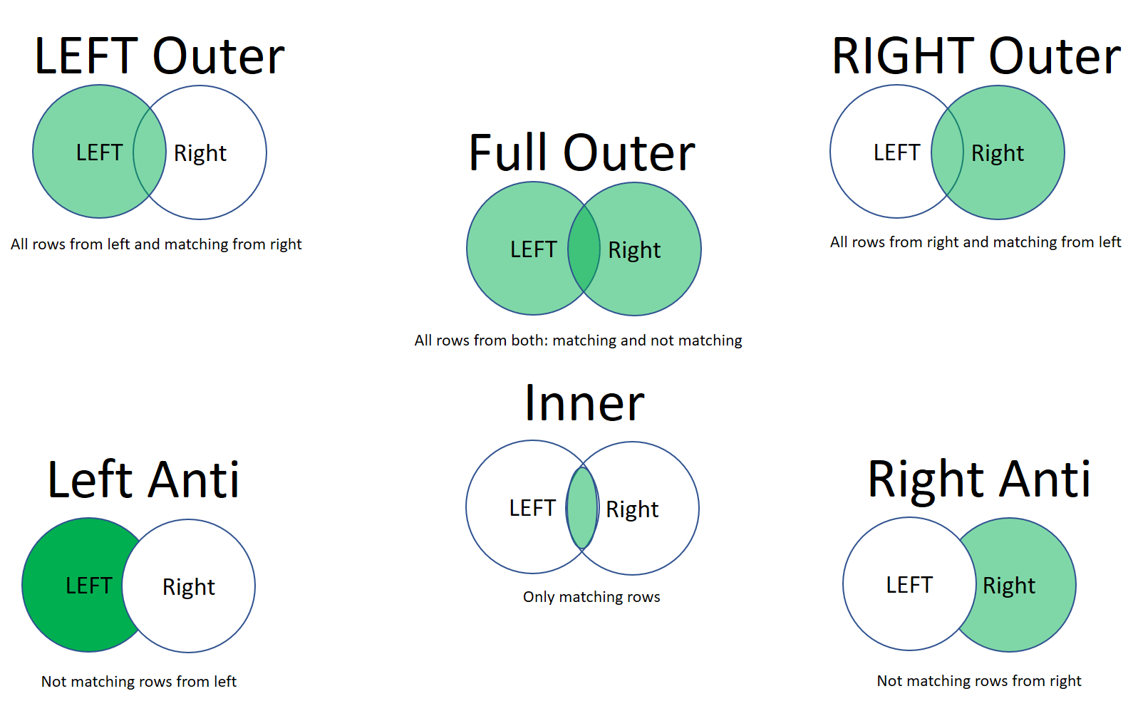

Slide 18
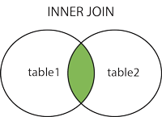
INNER JOIN
Inner joins (the typical join operation, which uses some comparison operator like = or <>). Inner joins use a comparison operator to match rows from two tables based on the values in common columns from each table. For example, retrieving all rows where the student identification number is the same in both the students and courses tables.
-- SYNTAX INNER JOIN
SELECT column_name(s) FROM table1 INNER JOIN table2 ON table1.column_name = table2.column_name;

Slide 19
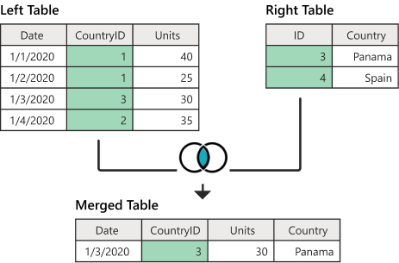
EXAMPLE: INNER JOIN

Slide 20
EXAMPLE: INNER JOIN CODE
DROP TABLE LeftTable ;
DROP TABLE RightTable ;
CREATE TABLE LeftTable(
date DATE,
country_id INT,
units INT
);
INSERT INTO LeftTable(date, country_id, units)
VALUES
('1-1-2020', 1, 40),
('1-1-2020', 1, 25),
('1-3-2020', 3, 30),
('1-4-2020', 2, 35);
CREATE TABLE RightTable(
id INT,
country VARCHAR(15)
);
INSERT INTO RightTable(id, country)
VALUES
(3, 'Panama'),
(4, 'Spain’);
SELECT *
FROM LeftTable;
SELECT *
FROM RightTable;

Slide 21
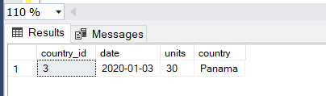
EXAMPLE: INNER JOIN RESULTS
-- INNER JOIN
SELECT l.country_id, l.date, l.units, r.country
FROM LeftTable AS l
INNER JOIN RightTable AS r
ON l.country_id = r.id;

Slide 22
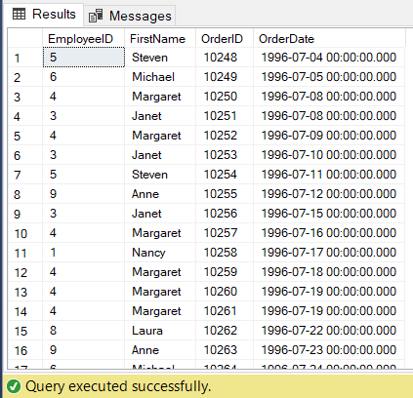
INNER JOIN NORTHWIND EXAMPLE
-- INNER JOIN EXAMPLE 2
SELECT *
FROM Employees;
SELECT *
FROM Orders;
SELECT
Employees.EmployeeID,
Employees.FirstName,
Orders.OrderID,Orders.OrderDate
FROM Employees
INNER JOIN Orders
ON Employees.EmployeeID=Orders.EmployeeID;

Slide 23
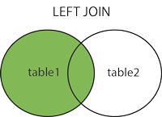
LEFT OUTER JOIN
The result set of a left outer join includes all the rows from the left table specified in the LEFT OUTER clause, not just the ones in which the joined columns match. When a row in the left table has no matching rows in the right table, the associated result set row contains null values for all select list columns coming from the right table.
Note: In some databases LEFT JOIN is called LEFT OUTER JOIN.
-- SYNTAX INNER JOIN
SELECT column_name(s) FROM table1 LEFT JOIN table2 ON table1.column_name = table2.column_name;

Slide 24
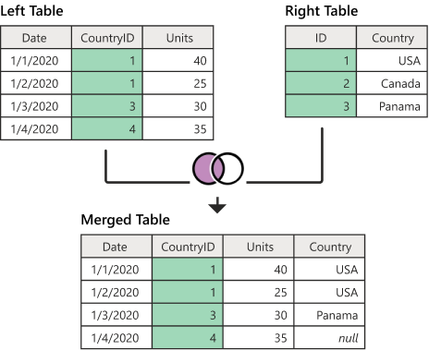

Slide 25
EXAMPLE: LEFT JOIN CODE
CREATE TABLE RightTable(
id INT,
country VARCHAR(15)
);
INSERT INTO RightTable(id, country)
VALUES
(1, 'USA'),
(2, 'Canada'),
(3, 'Panama’);
SELECT *
FROM LeftTable;
SELECT *
FROM RightTable;
DROP TABLE LeftTable ;
DROP TABLE RightTable ;
CREATE TABLE LeftTable(
date DATE,
country_id INT,
units INT
);
INSERT INTO LeftTable(date, country_id, units)
VALUES
('1-1-2020', 1, 40),
('1-1-2020', 1, 25),
('1-3-2020', 3, 30),
('1-4-2020', 4, 35);

Slide 26
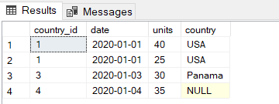
EXAMPLE: INNER JOIN RESULTS
-- LEFT OUTER JOIN
SELECT l.country_id, l.date, l.units, r.country
FROM LeftTable AS l
LEFT JOIN RightTable AS r
ON l.country_id = r.id;

Slide 27
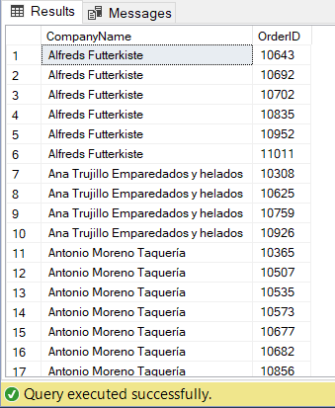
LEFT JOIN NORTHWIND EXAMPLE
-- LEFT OUTER JOIN
SELECT *
FROM Customers;
SELECT *
FROM Orders;
SELECT Customers.CompanyName, Orders.OrderID
FROM Customers
LEFT JOIN Orders
ON Customers.CustomerID = Orders.CustomerID;

Slide 28
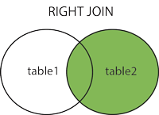
SQL RIGHT OUTER JOIN
This type of join returns all rows from the RIGHT-hand table specified in the ON condition and only those rows from the other table where the joined fields are equal (join condition is met).
Note: In some databases RIGHT JOIN is called RIGHT OUTER JOIN.
-- SYNTAX OF RIGHT JOIN
SELECT column_name(s) FROM table1 RIGHT JOIN table2 ON table1.column_name = table2.column_name;

Slide 29
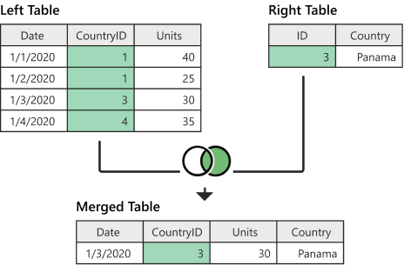

Slide 30
EXAMPLE: RIGHT JOIN CODE
CREATE TABLE RightTable(
id INT,
country VARCHAR(15)
);
INSERT INTO RightTable(id, country)
VALUES
(3, 'Panama');
SELECT *
FROM LeftTable;
SELECT *
FROM RightTable;
DROP TABLE LeftTable ;
DROP TABLE RightTable ;
CREATE TABLE LeftTable(
date DATE,
country_id INT,
units INT
);
INSERT INTO LeftTable(date, country_id, units)
VALUES
('1-1-2020', 1, 40),
('1-1-2020', 1, 25),
('1-3-2020', 3, 30),
('1-4-2020', 4, 35);

Slide 31

EXAMPLE: RIGHT JOIN RESULTS
-- RIGHT OUTER JOIN
SELECT l.country_id, l.date, l.units, r.country
FROM LeftTable AS l
RIGHT JOIN RightTable AS r
ON l.country_id = r.id;

Slide 32
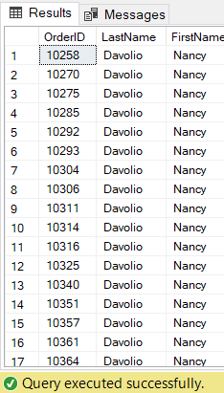
RIGHT JOIN NORTHWIND EXAMPLE
-- RIGHT JOIN EXAMPLE
SELECT *
FROM Employees;
SELECT *
FROM Orders;
SELECT
Orders.OrderID,
Employees.LastName,
Employees.FirstName
FROM Orders
RIGHT JOIN Employees
ON Orders.EmployeeID = Employees.EmployeeID;

Slide 33
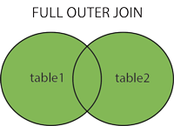
FULL JOIN
This type of join returns all rows from the LEFT-hand table and RIGHT-hand table with nulls in place where the join condition is not met. This Join can also be referred to as a FULL OUTER JOIN or a FULL JOIN.
NOTE: FULL OUTER JOIN and FULL JOIN are the same.
-- SYNTAX OF FULL OUTER JOIN
SELECT column_name(s) FROM table1 FULL OUTER JOIN table2 ON table1.column_name = table2.column_name WHERE condition;

Slide 34
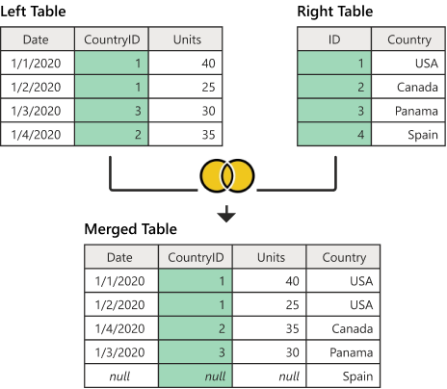

Slide 35
EXAMPLE: FULL JOIN CODE
CREATE TABLE RightTable(
id INT,
country VARCHAR(15)
);
INSERT INTO RightTable(id, country)
VALUES
(1, 'USA'),
(2, 'Canada'),
(3, 'Panama'),
(4, 'Spain');
SELECT *
FROM LeftTable;
SELECT *
FROM RightTable;
DROP TABLE LeftTable ;
DROP TABLE RightTable ;
CREATE TABLE LeftTable(
date DATE,
country_id INT,
units INT
);
INSERT INTO LeftTable(date, country_id, units)
VALUES
('1-1-2020', 1, 40),
('1-1-2020', 1, 25),
('1-3-2020', 3, 30),
(‘1-2-2020', 4, 35);

Slide 36
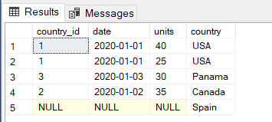
EXAMPLE: FULL OUTER JOIN RESULTS
-- FULL OUTER JOIN
SELECT l.country_id, l.date, l.units, r.country
FROM LeftTable AS l
FULL OUTER JOIN RightTable AS r
ON l.country_id = r.id;

Slide 37
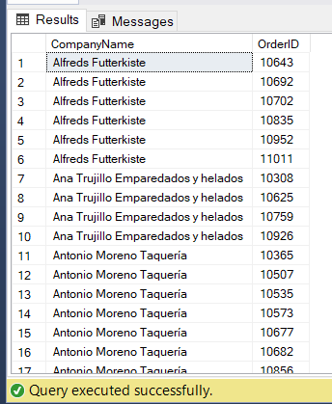
FULL JOIN NORTHWIND EXAMPLE
-- FULL OUTER JOIN
SELECT *
FROM Customers;
SELECT *
FROM Orders;
SELECT Customers.CompanyName, Orders.OrderID
FROM Customers
FULL OUTER JOIN Orders
ON Customers.CustomerID=Orders.CustomerID;

Slide 38
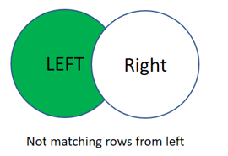
LEFT ANTI JOIN
One of the join kinds available is a left anti join, which brings in only rows from the left table that don't have any matching rows from the right table.
NOTE: FULL OUTER JOIN and FULL JOIN are the same.

Slide 39
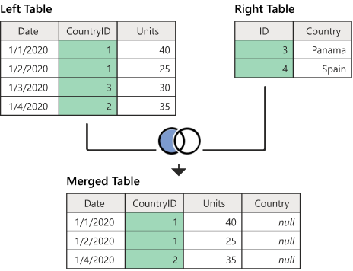

Slide 40
EXAMPLE: LEFT ANTI JOIN CODE
CREATE TABLE RightTable(
id INT,
country VARCHAR(15)
);
INSERT INTO RightTable(id, country)
VALUES
(1, 'USA'),
(2, 'Canada'),
(3, 'Panama'),
(4, 'Spain');
SELECT *
FROM LeftTable;
SELECT *
FROM RightTable;
DROP TABLE LeftTable ;
DROP TABLE RightTable ;
CREATE TABLE LeftTable(
date DATE,
country_id INT,
units INT
);
INSERT INTO LeftTable(date, country_id, units)
VALUES
('1-1-2020', 1, 40),
('1-1-2020', 1, 25),
('1-3-2020', 3, 30),
(‘1-2-2020', 4, 35);

Slide 41
HOME WORK
SIMILARLY: RIGHT ANTI JOIN RESULTS
REFERENCE| Right anti join | Microsoft Learn

Slide 42
FULL JOIN NORTHWIND EXAMPLE
-- FULL OUTER JOIN
SELECT *
FROM Customers;
SELECT *
FROM Orders;
SELECT Customers.CompanyName, Orders.OrderID
FROM Customers
FULL OUTER JOIN Orders
ON Customers.CustomerID=Orders.CustomerID;

Slide 43
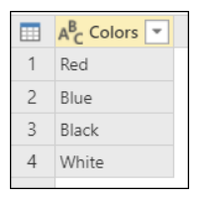
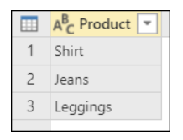
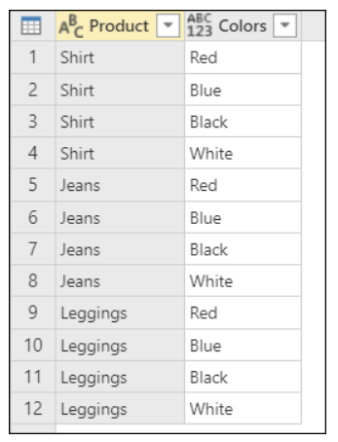
Cross Join
This returns the Cartesian product of rows from tables in the join. In other words, it will produce rows which combine each row from the first table with each row from the second table

Slide 44
EXAMPLE: CROSS JOIN CODE
CREATE TABLE products(
item VARCHAR(15)
);
CREATE TABLE colors(
color VARCHAR(15)
);
INSERT INTO products(item)
VALUES('shirt'),('Jeans'),('Leggings');
INSERT INTO colors(color)
VALUES('Red'),('Blue'),('Black'),('White');
SELECT * FROM products;
SELECT * FROM colors;

Slide 45
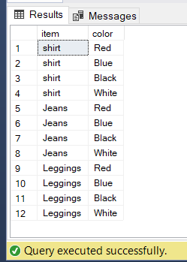
EXAMPLE: CROSS JOIN RESULTS
-- CROSS JOIN
SELECT p.item, c.color
FROM products AS p
CROSS JOIN colors c;

Slide 46
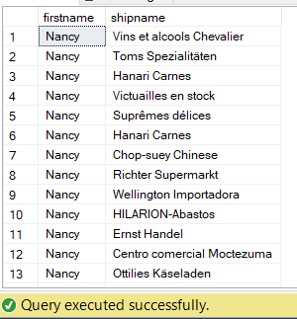
CROSS JOIN NORTHWIND EXAMPLE
--CROSS JOIN
SELECT e.firstname,o.shipname
FROM Employees e
CROSS JOIN Orders o

Slide 47
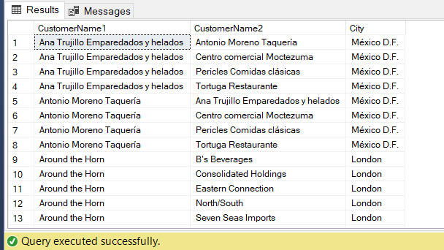
SELF JOIN
The SQL SELF JOIN is used to join a table to itself as if the table were two tables, temporarily renaming at least one table in the SQL statement.
-- SELF JOINS EXAMPLE
SELECT column_name(s) FROM table1 T1, table1 T2 WHERE condition;
-- SELF JOINS EXAMPLE
SELECT
A.CompanyName AS CustomerName1,
B.CompanyName AS CustomerName2,
A.City
FROM Customers A, Customers B
WHERE A.CustomerID <> B.CustomerID AND A.City = B.City;

Slide 48
THANK YOU
SLIDES BY: QASIM HASSAN

